Slide 1
Chapter 10
How to use Grid Layout for Responsive Web Design

Slide 2
Objectives
Applied
Use Grid Layout to lay out web pages or components within web pages, including the layouts for mobile devices.
Knowledge
In general terms, describe the use of Grid Layout.
Describe these terms as they apply to Grid Layout: grid, grid track, grid line, grid cell, grid area, and grid item.
In general terms, describe these ways to define the grid areas for the elements of a page: numbered lines, template areas, and the 12-column grid concept.

Slide 3
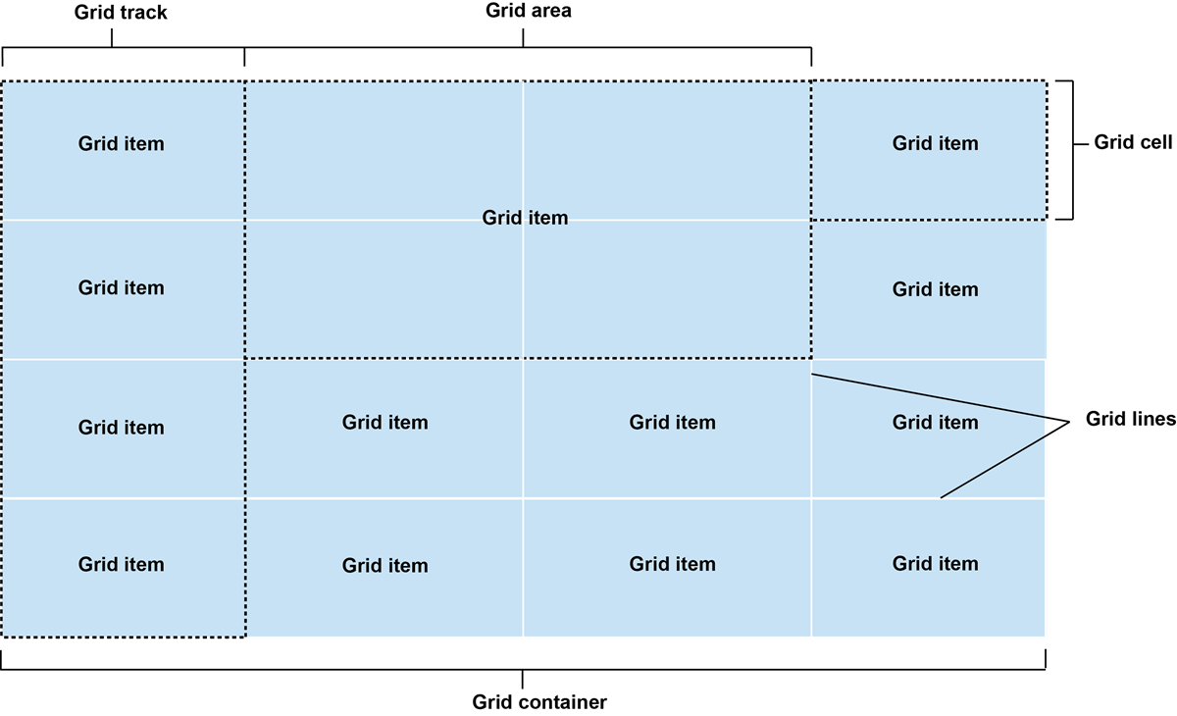
The components of a grid layout

Slide 4
The HTML and CSS for a 2 row by 3 column grid
The HTML
<main>
<div>Div 1</div> <div>Div 2</div> <div>Div 3</div>
<div>Div 4</div> <div>Div 5</div> <div>Div 6</div>
</main>
The CSS for laying out the grid
div { background-color: #C8DFEE; }
main {
display: grid; grid-template: 100px 100px / 150px 150px 150px;
grid-gap: 15px 20px; }

Slide 5
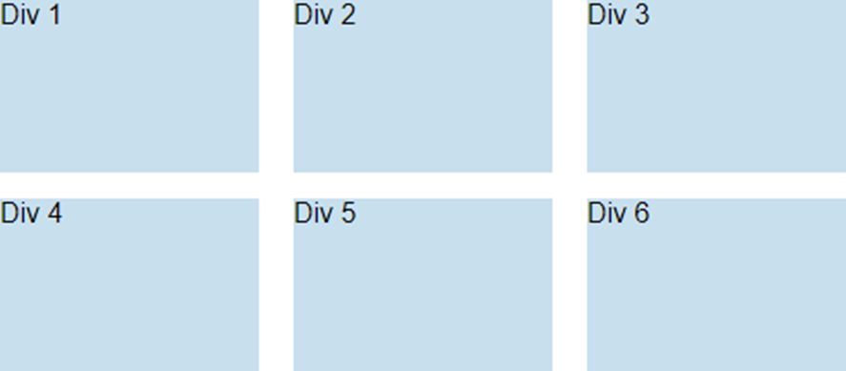
The layout for the 2x3 grid

Slide 6
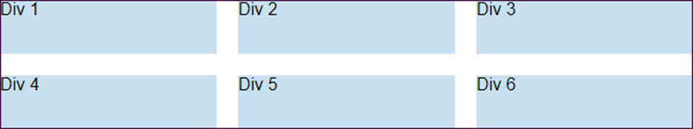
CSS that uses the repeat() function
main {
display: grid;
grid-template: repeat(2, 50px) / repeat(3, 1fr);
grid-gap: 20px; }
The resulting layout

Slide 7
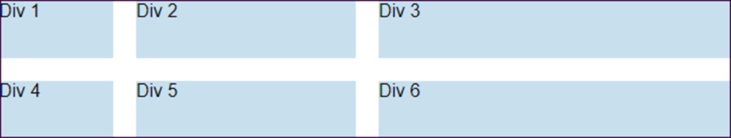
CSS that uses mixed units
main {
display: grid;
grid-template: repeat(2, 50px) / 100px 30% 1fr;
grid-gap: 20px; }
The resulting layout

Slide 8
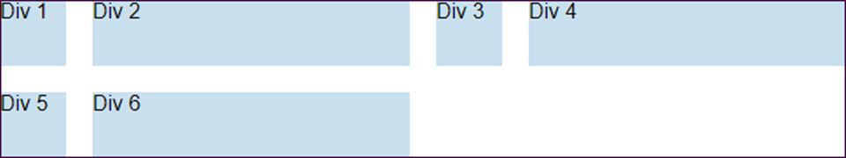
CSS that repeats two columns
main {
display: grid;
grid-template:
repeat(2, 50px) / repeat(2, 50px 1fr);
grid-gap: 20px; }
The resulting layout

Slide 9
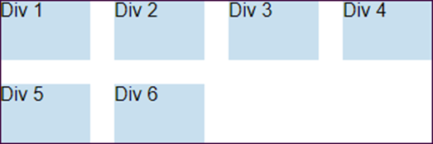
CSS that uses auto-fit and the minmax() function with the repeat() function
main {
display: grid;
grid-template:
repeat(2, 50px) / repeat(auto-fit, minmax(75px, 1fr));
grid-gap: 20px; }
The layout when the container is 360 pixels wide
The layout when the container is 720 pixels wide

Slide 10
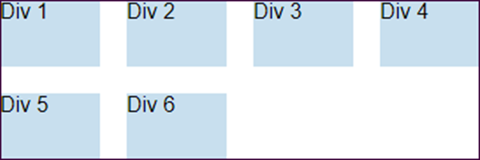
CSS that uses auto-fill and the minmax() function
main {
display: grid;
grid-template:
repeat(2, 50px) / repeat(auto-fill, minmax(75px, 1fr));
grid-gap: 20px; }
The layout when the container is 360 pixels wide
The layout when the container is 720 pixels wide

Slide 11
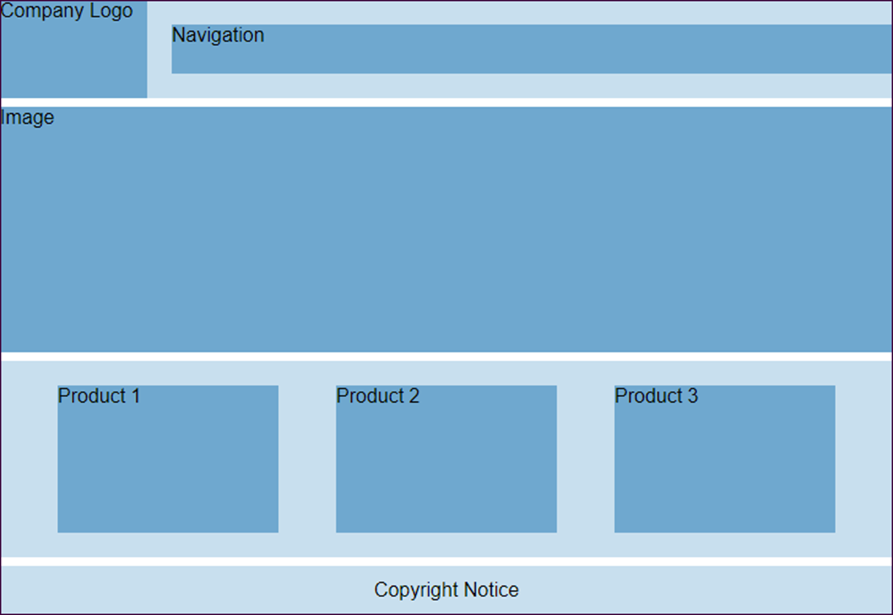
A page layout that uses alignment

Slide 12
The HTML for the body of the page
<body>
<nav>
<div>Company Logo</div>
<div>Navigation</div>
</nav>
<section>
<div>Image</div>
</section>
<main>
<div>Product 1</div>
<div>Product 2</div>
<div>Product 3</div>
</main>
<footer><p>Copyright Notice</p></footer>
</body>

Slide 13
Some of the CSS for the page
nav, section, main, footer {
display: grid;
width: 100%; }
nav {
grid-template: 80px / 120px 1fr;
grid-gap: 20px; }
nav div:nth-of-type(2) {
height: 40px;
align-self: center; }
section { grid-template-rows: 200px; }
main {
height: 160px;
grid-template: 120px / repeat(3, 180px);
align-content: center;
justify-content: space-evenly; }
footer {
height: 40px;
align-items: center;
justify-items: center; }

Slide 14
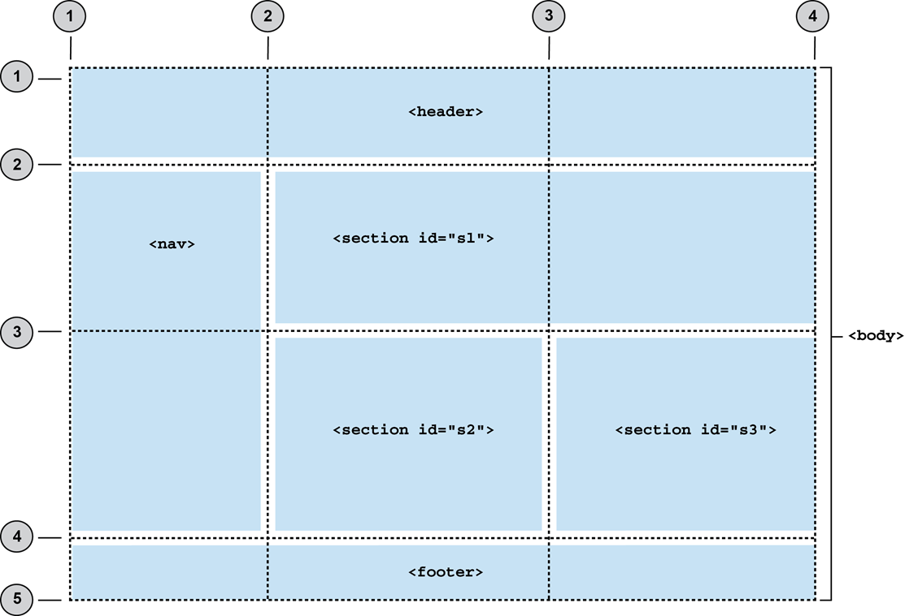
Numbered grid lines for a grid container

Slide 15
Numbered lines that define the grid areas
body {
margin: 0;
height: 600px; width: 100%; display: grid; grid-template-columns: 200px 1fr 1fr;
grid-template-rows: 80px 1fr 1fr 60px;
grid-gap: 16px; }
header { grid-row: 1 / 2; grid-column: 1 / 4; }
nav { grid-row: 2 / 4; grid-column: 1 / 2; }
#s1 { grid-row: 2 / 3; grid-column: 2 / 4; }
#s2 { grid-row: 3 / 4; grid-column: 2 / 3; }
#s3 { grid-row: 3 / 4; grid-column: 3 / 4; }
footer { grid-row: 4 / 5; grid-column: 1 / 4; }

Slide 16
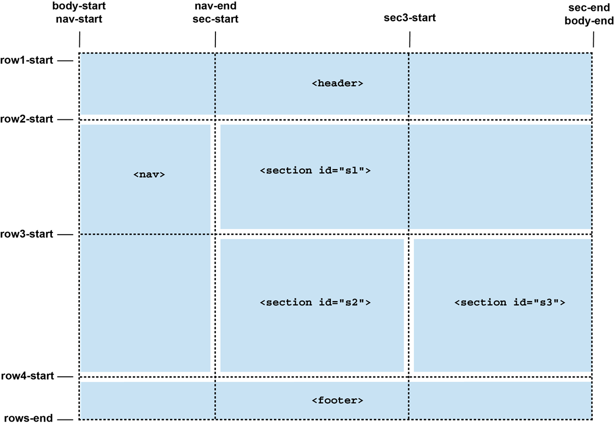
Named lines for a grid container

Slide 17
Named lines that define the grid areas
body { display: grid;
grid-template-columns: [body-start nav-start] 200px
[nav-end sec-start] 1fr
[sec3-start] 1fr [sec-end body-end];
grid-template-rows: [row1-start] 80px [row2-start] 1fr [row3-start] 1fr [row4-start] 60px [rows-end];
grid-gap: 16px; }
header { grid-row: row1-start/row2-start;
grid-column: body-start/body-end; }
nav { grid-row: row2-start/row4-start;
grid-column: nav-start/nav-end; }
#s1 { grid-row: row2-start/row3-start;
grid-column: sec-start/sec-end; }
#s2 { grid-row: row3-start/row4-start;
grid-column: sec-start/sec3-start; }
#s3 { grid-row: row3-start/row4-start;
grid-column: column3-start/content-end; }
footer { grid-row: row4-start/rows-end;
grid-column: body-start/body-end; }

Slide 18
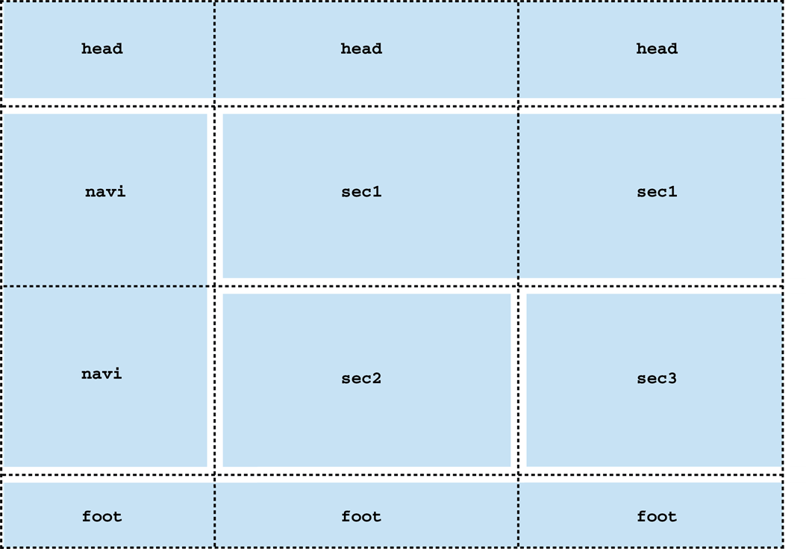
The template names for the cells within a grid container

Slide 19
Using template names to define the grid areas
body {
display: grid;
grid-template-columns: 200px 1fr 1fr;
grid-template-rows: 80px 1fr 1fr 60px;
grid-gap: 16px;
grid-template-areas:
"head head head"
"navi sec1 sec1"
"navi sec2 sec3"
"foot foot foot"; }
header { grid-area: head; }
nav { grid-area: navi; }
#s1 { grid-area: sec1; }
#s2 { grid-area: sec2; }
#s3 { grid-area: sec3; }
footer { grid-area: foot; }

Slide 20
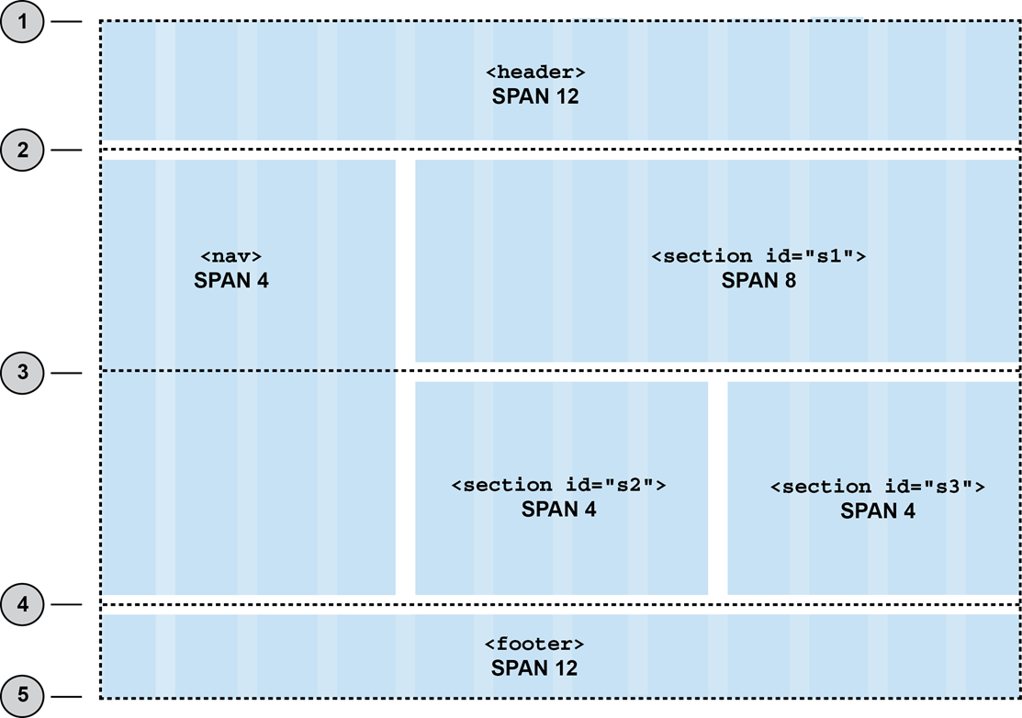
The 12-column grid for a grid container

Slide 21
Using a 12-column grid to define the grid areas
body {
display: grid;
grid-template-columns: repeat(12, 1fr);
grid-template-rows: 80px 1fr 1fr 60px;
grid-gap: 16px; }
header { grid-row: 1 / 2; grid-column: 1 / span 12; }
nav { grid-row: 2 / 4; grid-column: 1 / span 4; }
#s1 { grid-row: 2 / 3; grid-column: 5 / span 8; }
#s2 { grid-row: 3 / 4; grid-column: 5 / span 4; }
#s3 { grid-row: 3 / 4; grid-column: 9 / span 4; }
footer { grid-row: 4 / 5; grid-column: 1 / span 12; }

Slide 22
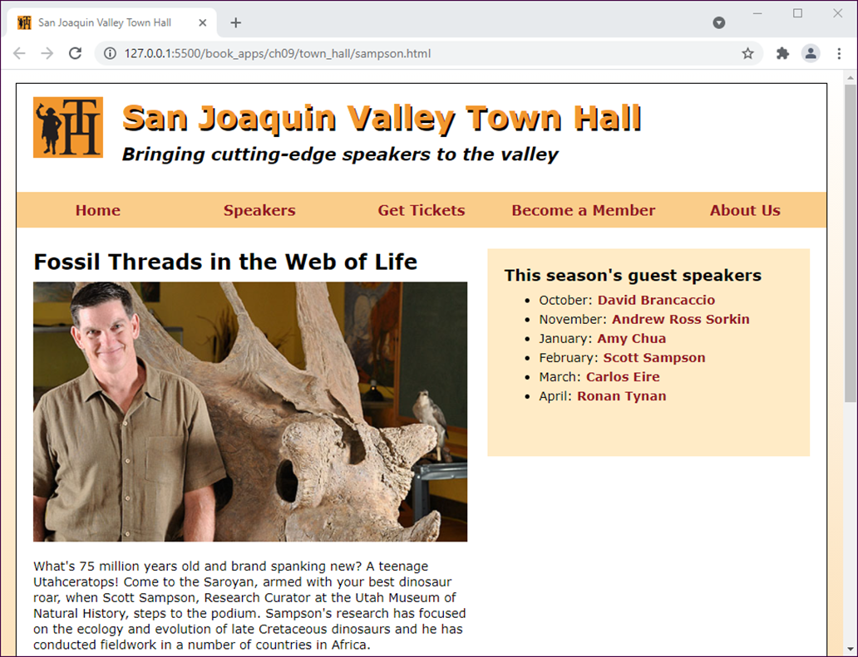
A speaker page in desktop layout

Slide 23
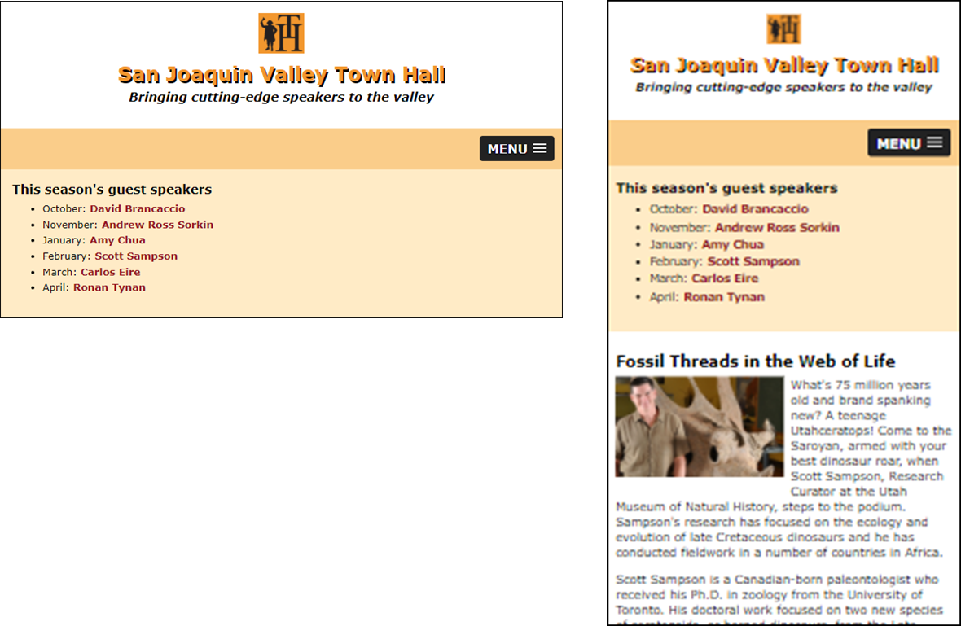
A speaker page in mobile layout

Slide 24
The HTML for the structural elements
<body>
<header>...</header>
<nav id="mobile_menu"></nav>
<nav id="nav_menu">
<ul>
<li><a href="index.html">Home</a></li>
...
</ul>
</nav>
<main>
<article>...</article>
<aside>
<h2>This season's guest speakers</h2>
<nav>
<ul> </ul>
</nav>
</aside>
</main>
<footer>...</footer>
</body>

Slide 25
CSS that uses template areas
body {
...
display: grid;
grid-template: repeat(4, auto) / 1fr;
grid-gap: 1.5em;
grid-template-areas:
"head"
"navi"
"main"
"foot"; }
header {
grid-area: head; }
#nav_menu {
grid-area: navi; }
#nav_menu ul {
...
display: grid;
grid-template: auto / repeat(5, 1fr);
align-content: center; }

Slide 26
CSS that uses template areas (continued)
main {
margin: 0 2%;
grid-area: main;
display: grid;
grid-template: auto / 1fr 40%;
grid-gap: 2%;
grid-template-areas:
"arti side"; }
article {
grid-area: arti; }
aside {
max-height: 200px;
min-height: 180px;
padding: 5%;
background-color: #ffebc6;
grid-area: side; }
footer { grid-area: foot; }

Slide 27
The media query for smaller screens that uses template areas
@media only screen and (max-width: 796px) {
body {
...
grid-gap: 0; /* no space between menu and main */
}
header {
padding-bottom: 1.5em; /* because no row gap */
display: grid; /* make header a grid */
grid-template: repeat(3, auto) / 1fr;
grid-gap: .3em;
justify-items: center; /* center horizontally */
}
#mobile_menu {
display: block;
grid-area: navi;
}

Slide 28
The media query for smaller screens that uses template areas (continued)
main {
margin: 0;
grid-template: auto auto / 1fr;
grid-gap: 2%;
grid-template-areas:
"side"
"arti";
}

Slide 29
The CSS for a 12-column grid
body {
...
display: grid;
grid-template: repeat(4, auto) / repeat(12, 1fr);
grid-gap: 1.5em;
}
header {
grid-row: 1 / 2;
grid-column: 1 / span 12;
}
#nav_menu {
grid-row: 2 / 3;
grid-column: 1 / span 12;
}

Slide 30
The CSS for a 12-column grid (continued)
article {
margin-left: 3.4%;
grid-row: 3 / 4;
grid-column: 1 / span 7;
}
aside {
...
margin-right: 5%;
grid-row: 3 / 4;
grid-column: 8 / span 5;
}
footer {
...
grid-row: 4 / 5;
grid-column: 1 / span 12;
}

Slide 31
The media query for smaller screens that uses a 12-column grid
@media only screen and (max-width: 796px) {
body {
...
grid-template: repeat(5, auto) / 1fr;
grid-gap: 0;
}
header {
grid-column: 1 / 2;
...
}
#mobile_menu {
display: block;
grid-row: 2 / 3;
grid-column 1 / 2;
}

Slide 32
The media query for smaller screens that uses a 12-column grid (continued)
article {
...
grid-row: 4 / 5;
grid-column: 1 / 2;
}
aside {
margin-right: 0;
padding: 1em 2%;
grid-row: 3 / 4;
grid-column: 1 / 2;
}
footer {
grid-row: 5 / 6;
grid-column: 1 / 2;
{
}

Slide 33
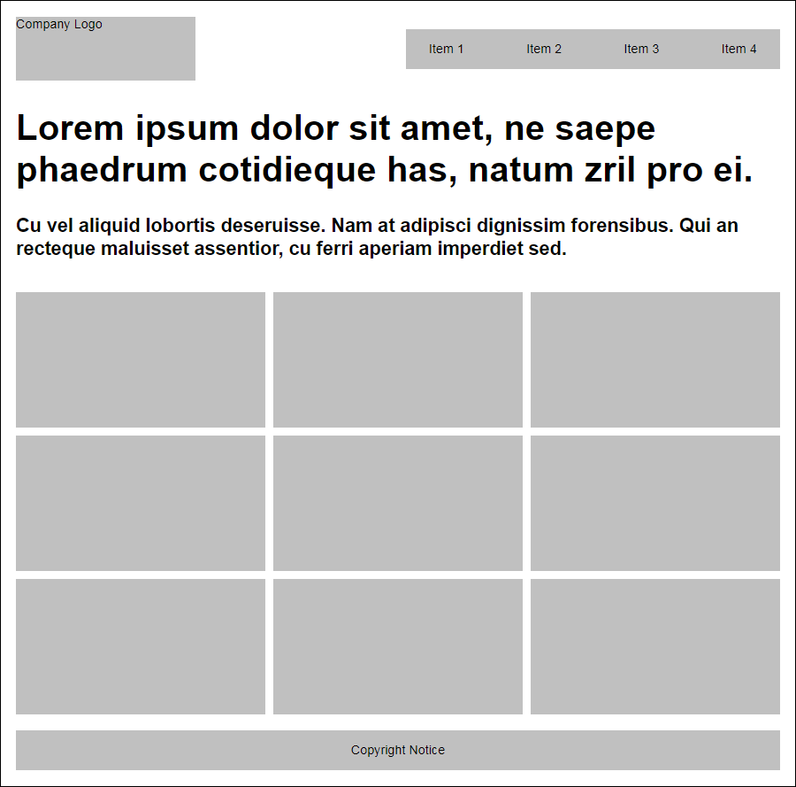
The headline and gallery layout

Slide 34
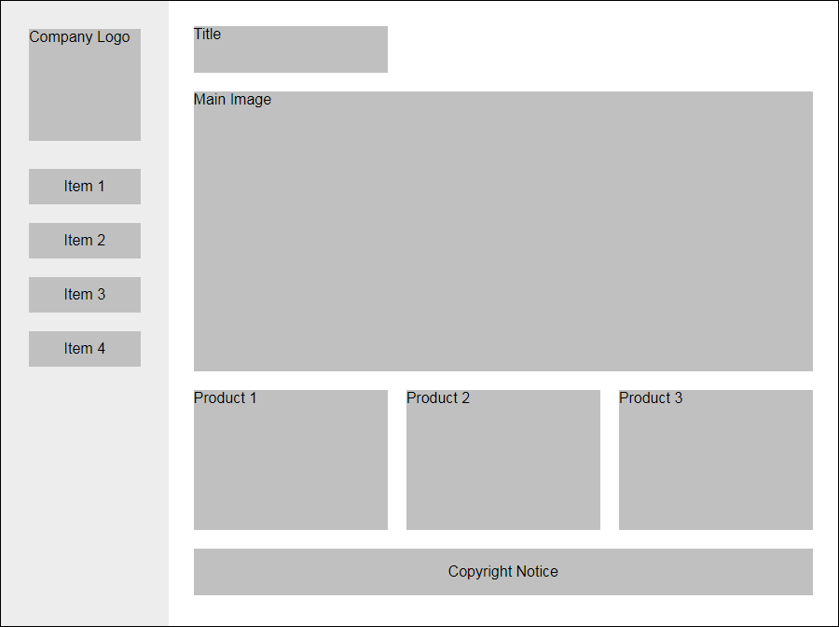
The fixed sidebar layout

Slide 35
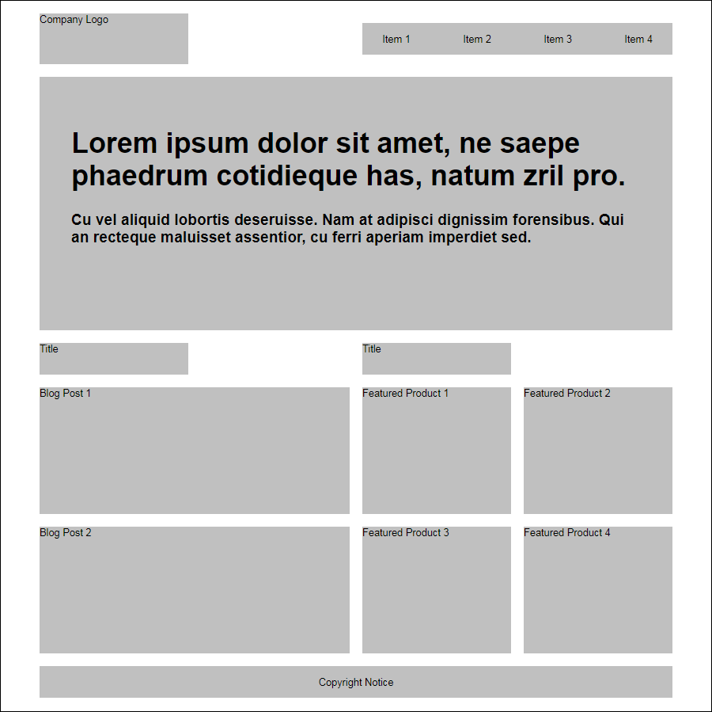
The advanced grid layout

Slide 36
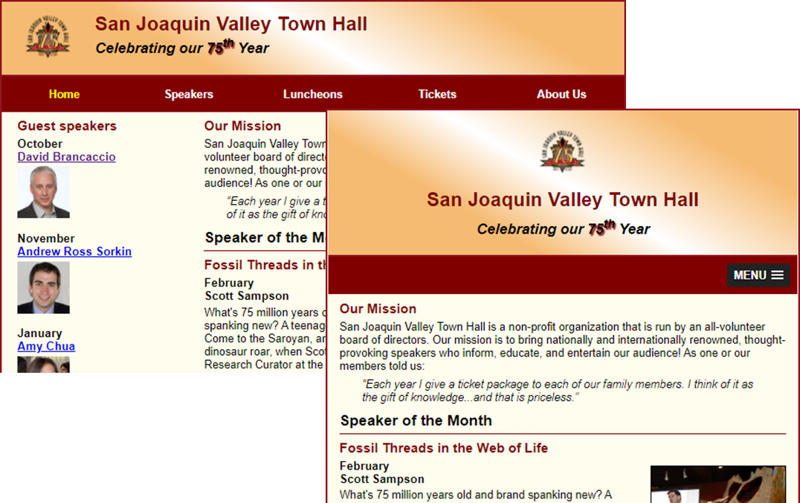
Short 10-1 Use a 12-column grid for the Town Hall home page

